Slide 1


Prepared By
A group of EPI students.

Slide 2

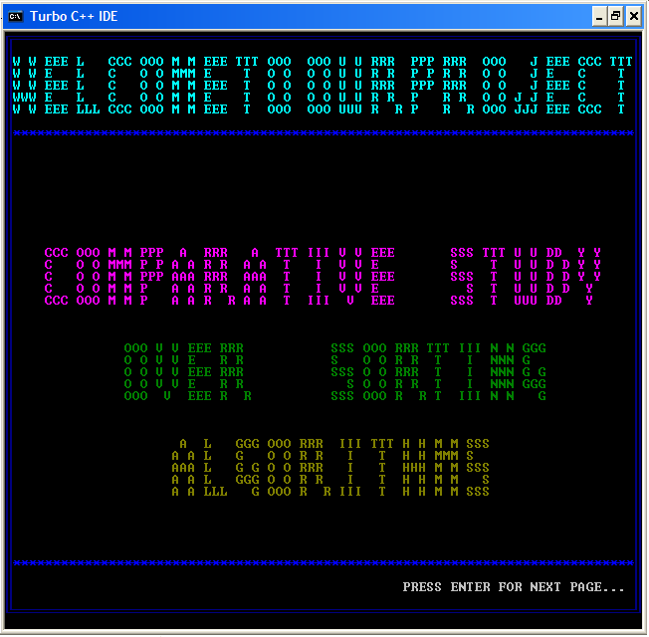

Slide 3

Project Name
Comparative Study Over Sorting Algorithms
Group Number
One (1)
Group Members
Seven (7)
Names
MD Rameez Raja
Manish Kumar Gupta
Arup Singha

Slide 4
MD Imran Ansari
Sujoya Das
Swarna Basu
Sarita Chaurasia
Lead By
MD Rameez Raja.
Under By
Toufique Sir.
Front End
C Language.
Back End
No such data base; Random input from the users.

Slide 5
Project Type
Analytical Project.
Project Objective
Study the Complexity for sorting algorithms.
Project Goal
If possible; proposed an algorithm which is best
sorting algorithm according to complexity.

Slide 6

Sorting is a process that organizes a collection of data into either ascending or descending order.
An internal sort requires that the collection of data fit entirely in the computer’s main memory.
We can use an external sort when the collection of data cannot fit in the computer’s main memory all at once but must reside in secondary storage such as on a disk.
We will analyze only internal sorting algorithms.
Sorting also has indirect uses. An initial sort of the data can significantly enhance the performance of an algorithm.

Slide 7
Majority of programming projects use a sort somewhere, and in many cases, the sorting cost determines the running time.
A comparison-based sorting algorithm makes ordering decisions only on the basis of comparisons.
Among different types of sorting algorithm each has
its advantages and disadvantages and to determine
which algorithm is better and faster for sorting a set
of data we have done a comparative study of
different types of sorting algorithms.

Slide 8

American flag sort
Bead sort
Bogo sort
Bubble sort
Bucket sort
Cartesian sort
Cocktail sort
Comb sort
Counting sort
Cycle sort

Slide 9
Flash sort
Heap sort
Insertion sort
Intro sort
Merge sort
Odd even sort
Quick sort
Radix sort
Selection sort
Shell sort

Slide 10

Input: An array A[1,2,………,n], where n is the number of elements.
Output: An array A with all elements in sorted order.
Remark: Sort the elements in ascending order.
STEPS:
1.For i=1 to n-1 do //outer loop with n-1 passes
2. For j=1 to n-i do //Inner loop;in the ith pass
3. If (A[j]>A[j+1]) then //check if two elements are 4.out of order
5. Swap(A[j], A[j+1]) //Interchange A[j] and A[j+1]
6. EndIf
7. EndFor
8.EndFor
9.Stop

Slide 11

#include<stdio.h>
void main()
{
int A[200],N,Temp,i,j;
clrscr();
printf("\n\t Enter how many elements you want:\n\t");
scanf("%d",&N);
printf("\n\tEnter the array elements to be sorted:\n");
for(i=0;i<N;i++)
{
printf("\t");

Slide 12
scanf("%d",&A[i]);
}
for(i=0;i<N-1;i++)
for(j=0;j<N-i;j++)
if(A[j]>A[j+1])
{
Temp = A[j];
A[j] = A[j+1];
A[j+1] = Temp;
}
printf("\n The array of elements after sorting:\n");

Slide 13
for(i=0; i<N; i++)
printf("\n\t%d",A[i]);
getch();
}

Slide 14

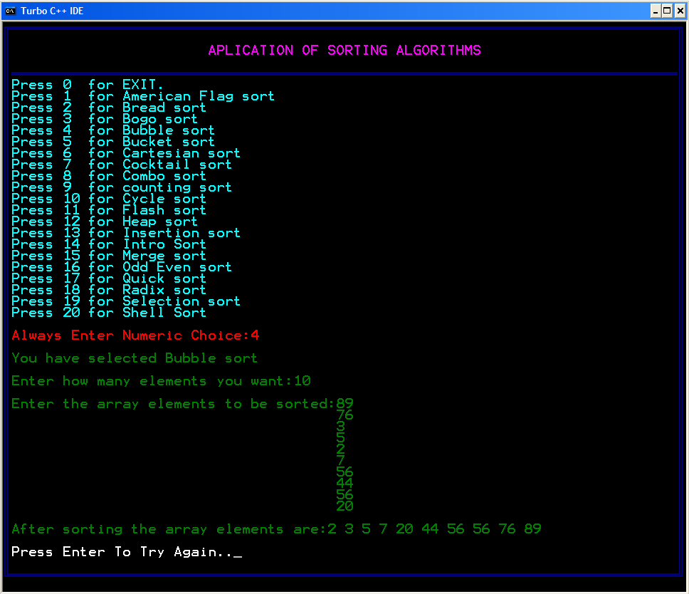

Slide 15

#include<conio.h>
#include<stdio.h>
void main()
{
int i,no;
printf("Enter number of lines :");
scanf("&d”,&no);
for(i=1;i<=no;i++)
{
printf("%d",i);
}
getch();
}
.

Slide 16

For given function g(n),we denote by o(g(n)) the set of functions that are different than g(n) by a constant Asymptotic upper bound.
Here, we assume that we should compare the algorithm in an independent machine, i.e; if there is different types of processor, then their system may vary the execution time depending on the instruction format for execution each and every operations. If we consider two different machine for any algorithm to measure the complexity then we should prefer ASSYMTOTIC NOTATION.

Slide 17

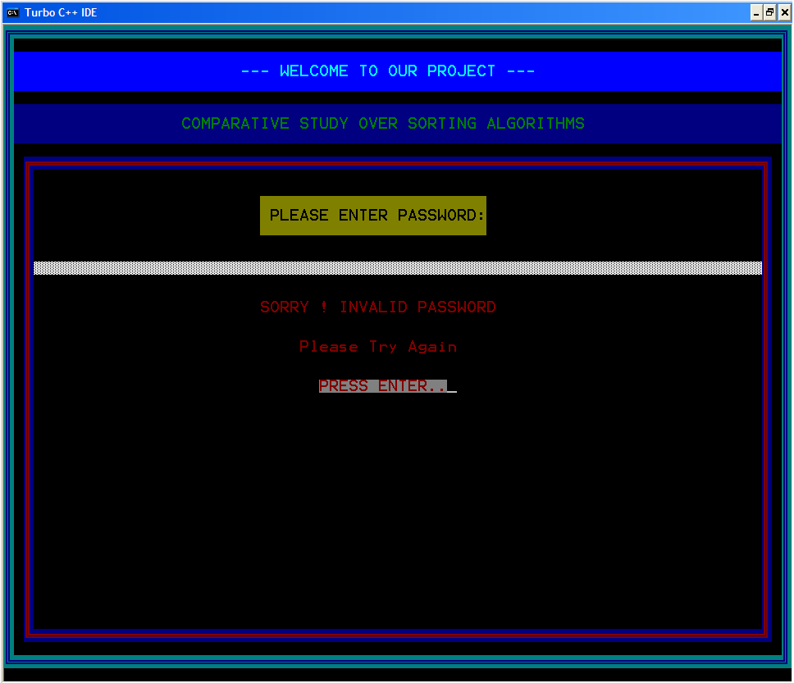

Slide 18

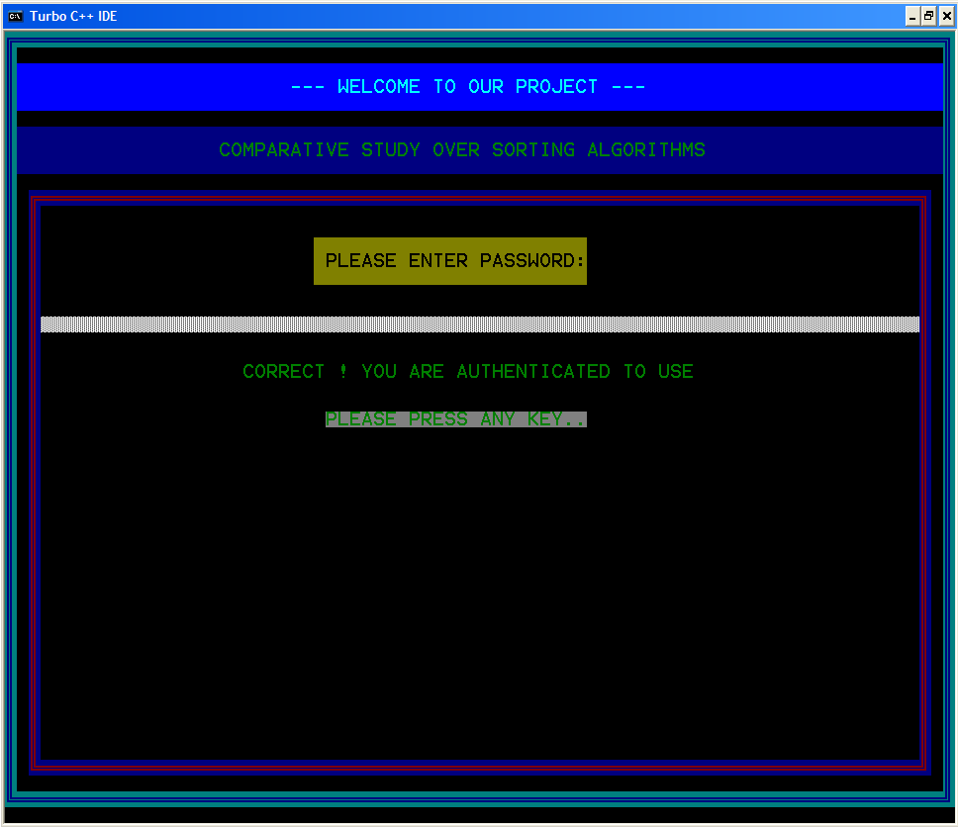

Slide 19

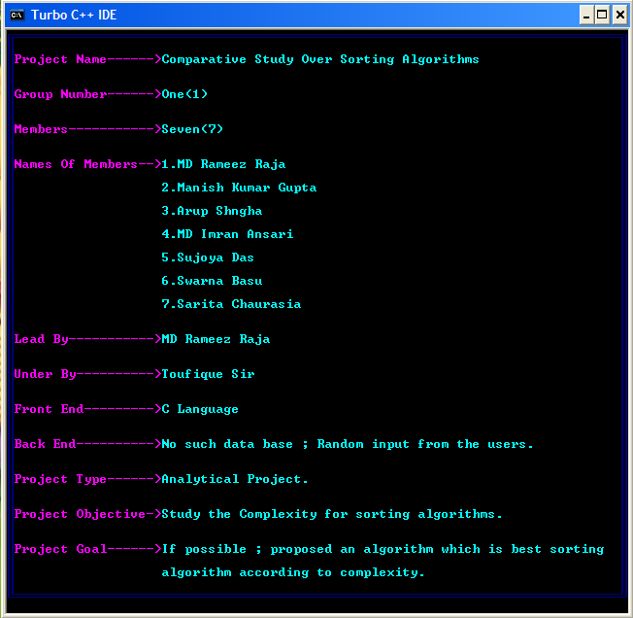

Slide 20

